Slide 1
Hand Gesture Recognition
Ranadeep - EDM18B046
Tulasi - EDM18B047
Bhanu Teja - EDM18B049
Varshith - EDM18B050

Slide 2
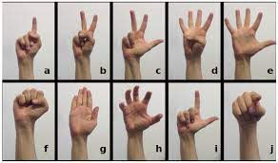
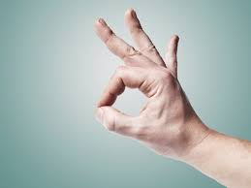
Introduction
The Healthcare monitoring on a clinical basis involves many implicit communication between the patient and the caretakers.Any misinterpretation leads to adverse effects. It has always been a challenge for hospitals to eliminate the miscommunications between healthcare providers and those they serve.
The demand for caretakers for elderly and the disabled has increased in great ratio.
A simple gesture recognition system can precisely interpret the implicit communication to the caretakers or to an automated support device. Simple and obvious hand movements can be used for the above purpose.

Slide 3
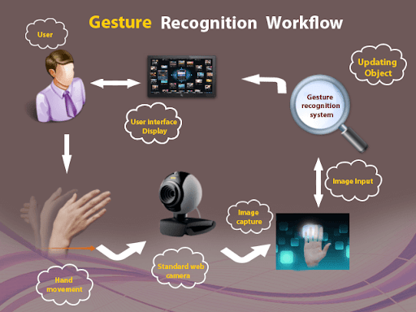
Applications
Hand gestures have boundless applications. Gesture recognition has wide-ranging applications such as the following:
developing aids for the hearing impaired, speech impaired
enabling very young children to interact with computers
designing techniques for forensic identification
designing techniques for forensic identification
medically monitoring patients’ emotional states or stress level
lie detection
navigating and/or manipulating in virtual environments
communicating in video conferencing
distance learning/tele-teaching assistance
monitoring automobile drivers alertness/drowsiness levels, etc.

Slide 4
Procedure:
Step 1: First image is captured from a stream using a web camera positioned such that it can be easily reached by the patient.
Step 2: Now the image is processed in matlab.
Step 3: Initially the hand is detected as a separate entity and background is eliminated.
Step 4: Now the program detects the open fingers by calculating their height.
Step 5: Finally, by counting the number of fingers in the hand gesture we decoded the gesture and there by displayed the corresponding comment for that gesture and also announced it in the form of voice.
Finally recognized output is converted into text and speech. Thus the system eliminates communication barriers.

Slide 5
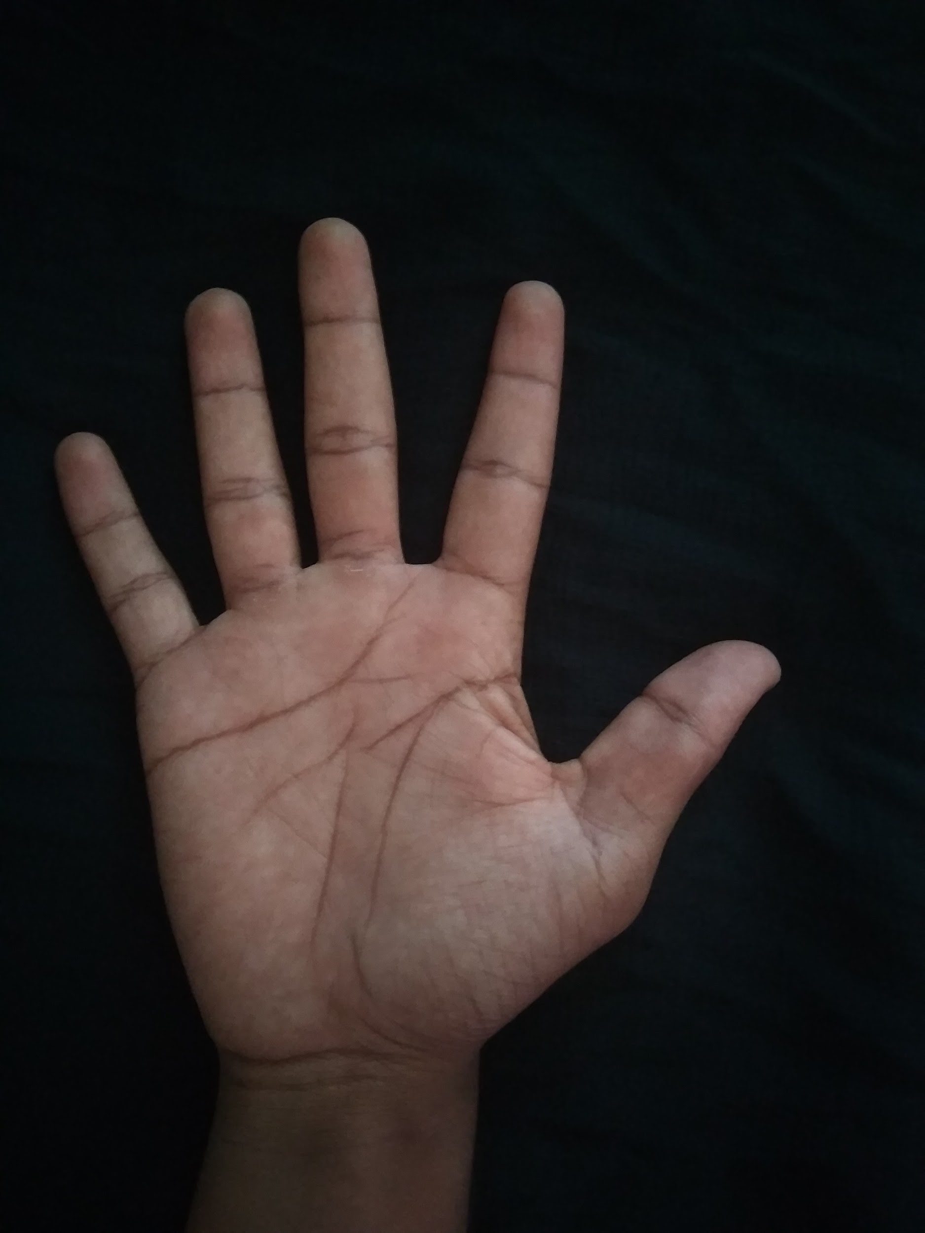
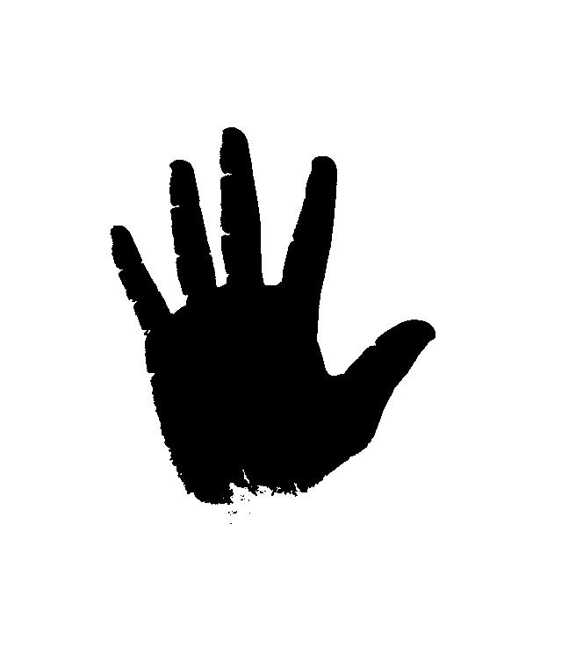
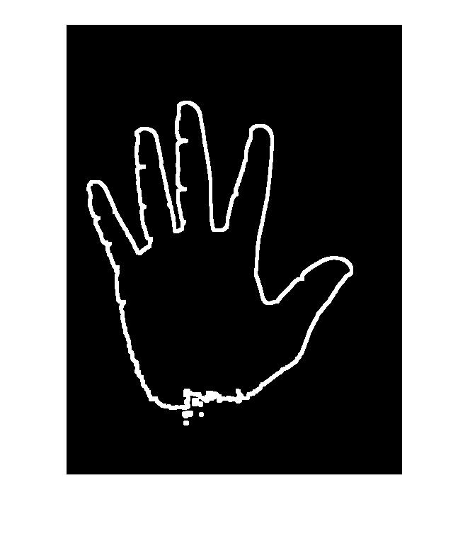
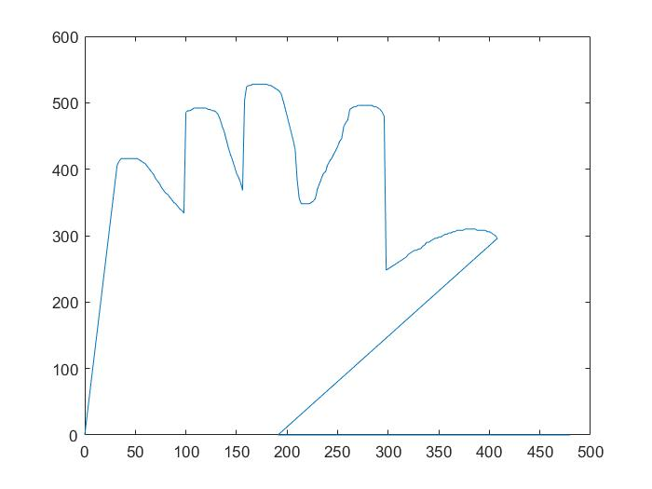
Software used: MATLAB
The proposed system is designed in real time mode to recognize 564564 gestures using MATLAB
MATLAB is a high-level language and interactive environment for numerical computation, visualization, and programming. Using MATLAB, you can analyze data, develop algorithms, and create models and applications. The language, tools, and built-in math functions enable you to explore multiple approaches and reach a solution faster than with spreadsheets or traditional programming languages, such as C/C++ or Java.

Slide 6
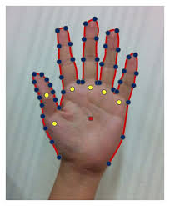
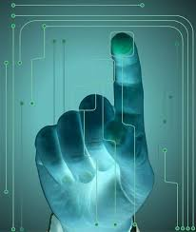
Conclusion
Hand gesture recognition system for patients using image processing was successfully executed with good accuracy. The method gives output in text and speech format that helps to reduce the communication gap.
On the whole, the solution aims to provide aid to those in need thus ensuring social relevance. The user-friendly nature of the system ensures that people can use it without any difficulty and complexity. The application is cost efficient and eliminates the usage of expensive technology.The scope of the project is to enhance the recognition capability for various lightning conditions and achieving more accuracy.

Slide 7
Thank You

